Slide 1
Addis Ababa Science and Technology University Department of Software Engineering
Fundamental of Database
Ch-3 slide
Lecturer: Yaynshet .M

Slide 2
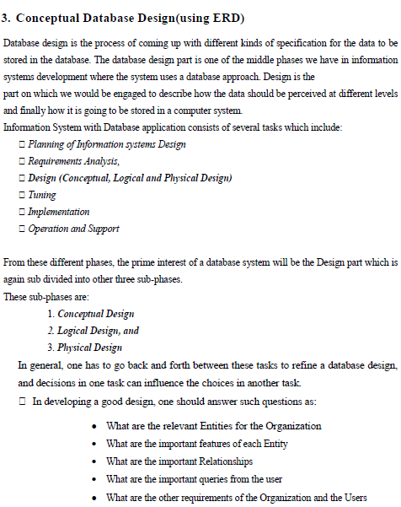

Slide 3
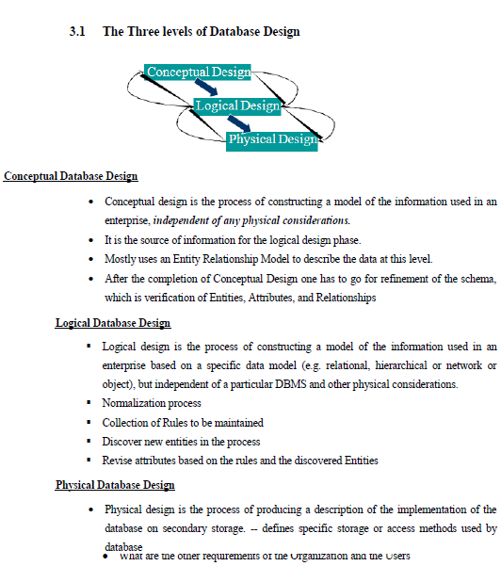

Slide 4
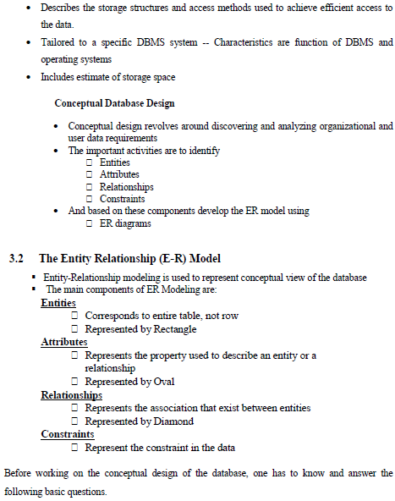

Slide 5
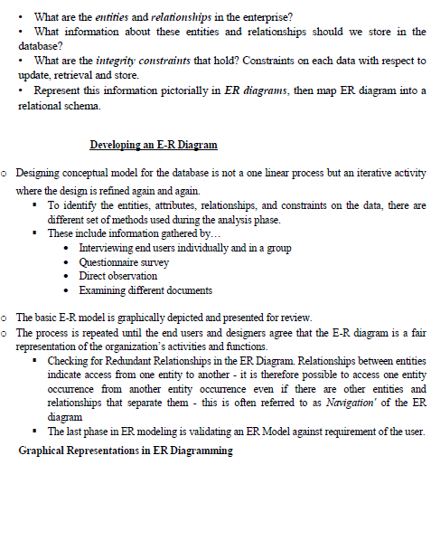

Slide 6
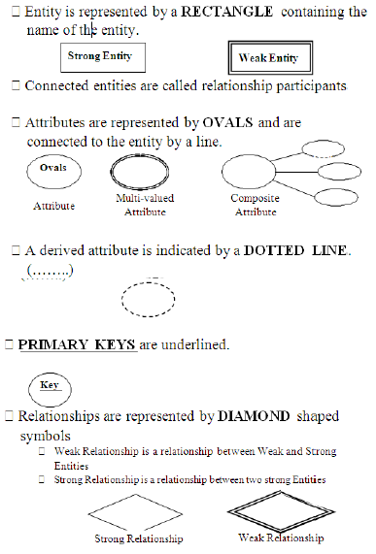

Slide 7
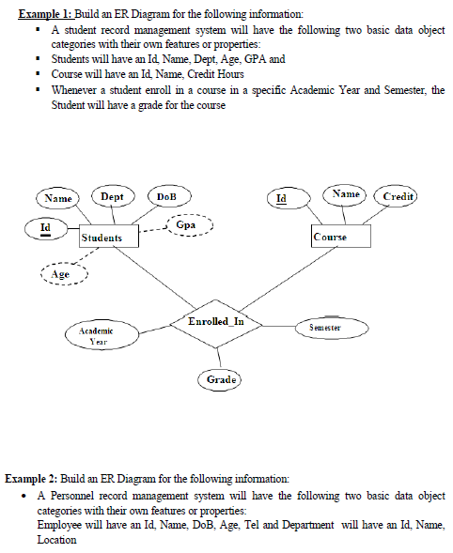

Slide 8
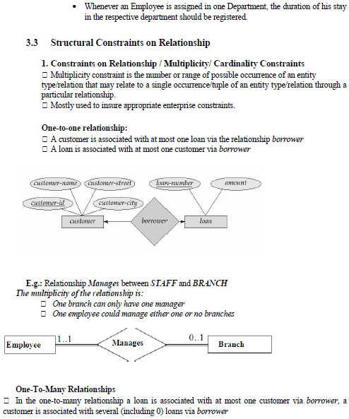

Slide 9
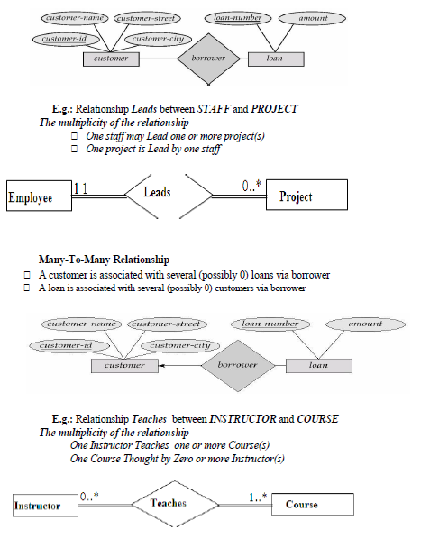

Slide 10
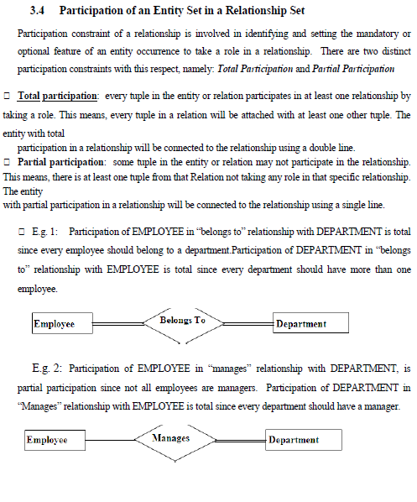

Slide 11
Go to
Ch. – 4 slide

